Slide 1

Smith & Robbins Superstore
Sales Performance Analysis
Olumide Balogun +234-8065060691
1

Slide 2
Executive Summary
Goals and Objectives Matrix
Exploring Descriptive, Diagnostic, Predictive, and Prescriptive Analytics: A Comprehensive Examination
Approach, Analysis, and Technical Challenges
Examinations – Charts, Tests, Plots, and Models
Key Findings from Descriptive, Diagnostic, Predictive, and Prescriptive Analytics
Final Recommendations
Contents
Olumide Balogun +234-8065060691
2

Slide 3
Executive Summary
This report offers a comprehensive analysis of Smith & Robbins’ Sales Performance from 2020 to 2023. The objective is to unveil insights into sales performance and profitability, identifying patterns, key trends, performance gaps, and customer behaviors. Additionally, it seeks to uncover correlations and areas for improvement, accompanied by actionable recommendations aimed at enhancing sales performance and informing strategic business decisions.
The key focus areas include:
Total Sales, Profit and Quantity along their Respective Percentage Growth
Top 15 Categories, Segments, and Regions by Sales and Profit
Analysis of Sales Performance and Profitability by Segment and Category Across Regions
Top-Performing Subcategories
Monthly Sales Cyclical Patterns
Month-over-Month Sales Comparison Using Time Series Analysis
The Impact of Quantity, Discount on Sales and Profitability
Features with the Greatest Impact on Sales and Profit Outcomes– Using Feature Importance and Regression Model
Trends and Seasonality in Sales
Forecasting Sales using ARIMA Model
Customer Segments That Drive the Most Sales
Olumide Balogun +234-8065060691
3

Slide 4
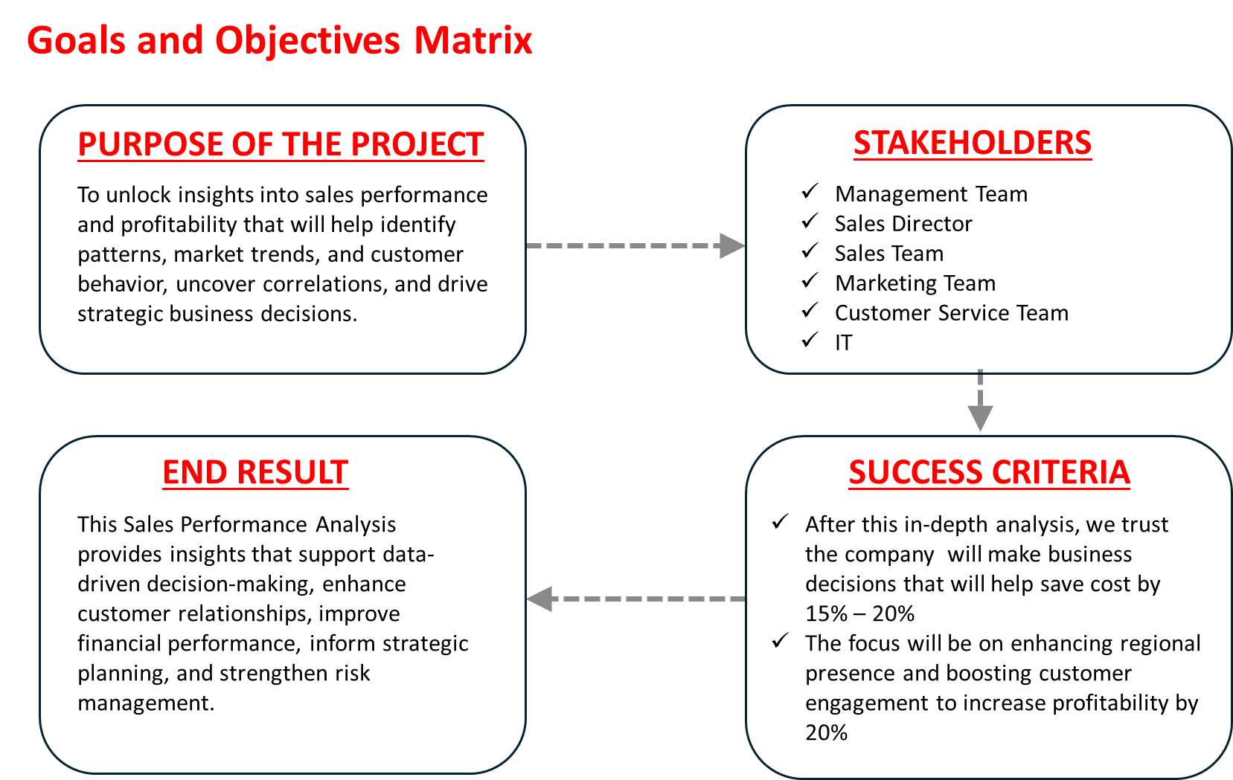
Olumide Balogun +234-8065060691
4

Slide 5
Exploring Descriptive, Diagnostic, Predictive, and Prescriptive Analytics: A Comprehensive Examination
1. What is the year-over-year Percentage Growth of Sales, Profit, and Quantity?
What are the top 15 Categories, Segments, and Regions based on Sales ?
What are the top 15 Categories, Segments, and Regions based on Profit ?
How does Sales vary across Regions within each Category?
How does Profit vary across Regions for each Category?
How does Sales vary across Regions within each Segment?
How does Profit vary across Regions for each Segment?
Which Subcategories that generate the highest Revenue?
Are certain Subcategories more Profitable than others?
What Month recorded the Highest and Lowest Sales?
Are we seeing Consistent Growth or Decline over Time?
What is the correlation between Sales and Profit?
What is the relationship between Sales and Quantity?
What is the relationship between Sales and Discount?
What Key Factors Contribute to Sales Performance?
What Key Factors Contribute to Profitability?
Are there Seasonal Patterns, and what is the Sales Trend over Time?
How will sales trends evolve over the next thirty-six months—will they be favorable or unfavorable?
Which customer segments drive the most sales?
Olumide Balogun +234-8065060691
5

Slide 6
Approach, Analysis and Technical Challenges
Data tables collected from the management team.
Formatted, compiled, cleaned, and transformed into a single dataset.
Addressed missing values, corrected misspellings, and changed data types.
Created calculated variables for analysis.
Utilized graphical visualization and statistical inference to uncover valuable insights.
Employed plots and models to extract meaningful insights.
Olumide Balogun +234-8065060691
6

Slide 7
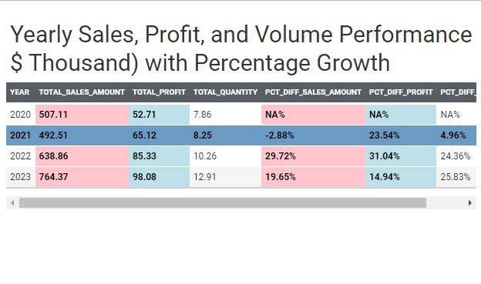
Q1. Total Sales, Profit and Quantity along their Respective Percentage Growth
Purpose: Assess the evolution of Sales, Profit, and Quantity over time to inform the business's overall performance.
Question : What is the year-over-year Percentage Growth of Sales, Profit, and Quantity?
Hypothesis: There are significant differences across the calculated fields.
Insights: 2023 stands out as the best-performing year, with total sales of $767.37 million and total profit of $98.08 million. In contrast, 2021 was the least performing year, with total sales of $492.51 million and total profit of $8.25 million.
Only 2021 recorded negative percentage growth of -2.88%. However, remarkable growth was observed in 2022 and 2023.
Olumide Balogun +234-8065060691
7

Slide 8
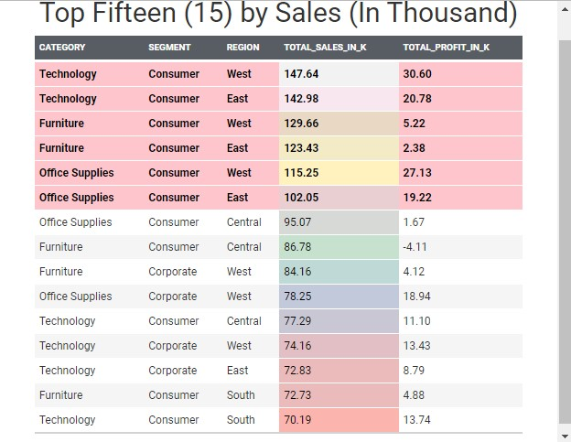
Q2 a. Top 15 Categories, Segments, and Regions by Sales
Purpose: Identify the top 15 Categories, Segments, and Regions ranked by Sales.
Question : What are the top 15 Categories, Segments, and Regions based on Sales ?
Hypothesis: There are significant differences across the top 15.
Insights: The top six (6) are from the consumer segments recording total sales exceeding $100 million. The top two segments belong to the technology category, generating over $140 million in sales and more than $20 million in profit.
The top six segments are highlighted in light pink, while the remaining segments are displayed in white. These represent the top 15 out of a total of 38.
Olumide Balogun +234-8065060691
8

Slide 9
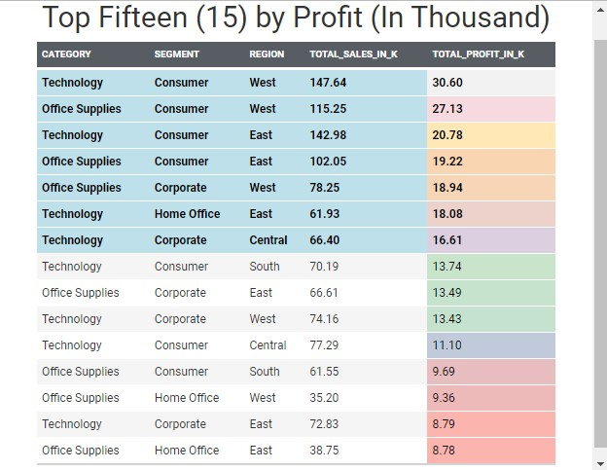
Q2 b. Top 15 Categories, Segments, and Regions by Profit
Purpose: Identify the top 15 Categories, Segments, and Regions ranked by Sales.
Question : What are the top 15 Categories, Segments, and Regions based on Profit ?
Hypothesis: There are significant differences across the top 15.
Insights: The top three (3) are from the consumer segments recording total profit exceeding $19 million and more than $100 million in sales, while the fist two are from western region and the third from eastern region.
The top seven (7) with a total profit exceeding $15 Million are highlighted in light blue, while the remaining segments are displayed in white. These represent the top 15 out of a total of 38.
Olumide Balogun +234-8065060691
9

Slide 10
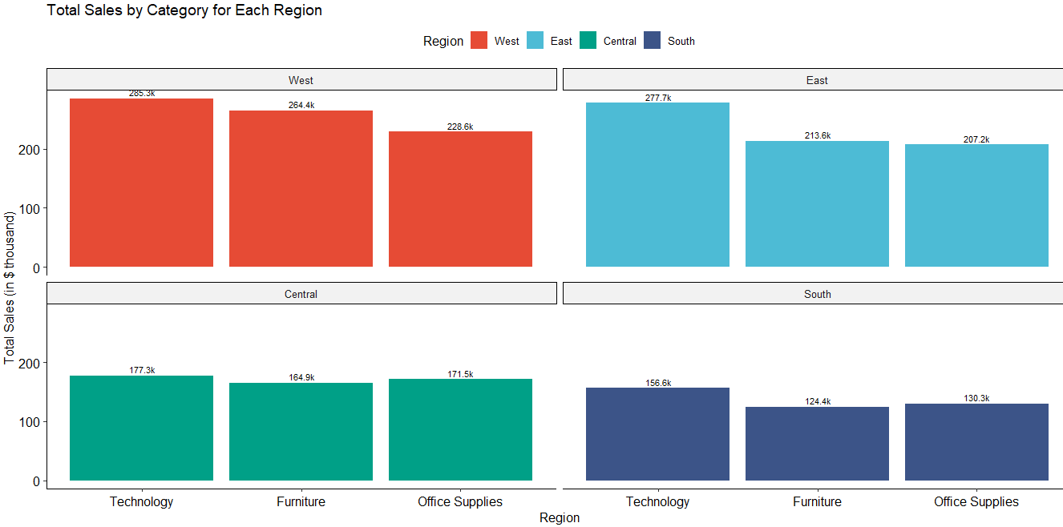
Q3a. Total Sales by Category for Each Region
Purpose: Evaluate whether there are significant differences in Sales by Category across Regions.
Question: How does Sales vary across Regions within each Category?
Hypothesis: There are significant differences in Sales across Regions. This suggests that regions perform variably in terms of sales. From a business perspective, this provides strong evidence that sales strategies differ considerably between regions.
Insights: The West is the top-performing region, achieving Total Sales of $778.3 million, while the South lags behind with approximately $411.2 million in Sales. Additionally, the Technology Category excels with Total Sales of $896.8 thousand, whereas Office Supplies is the least performing category, totaling $737.7 thousand in Sales.
In all, Technology from the West is the most performing with Total Sales of $285.3 thousand.
Olumide Balogun +234-8065060691
10

Slide 11
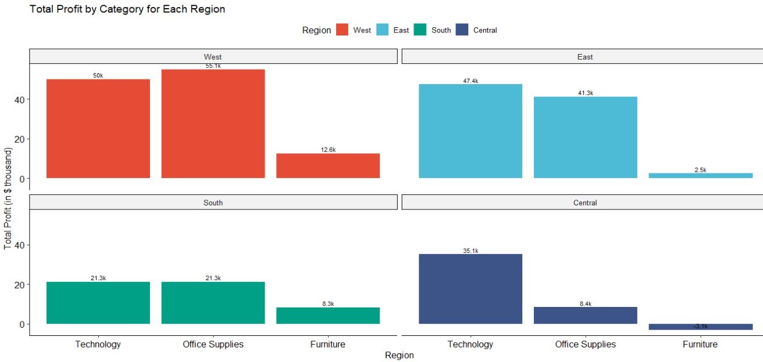
Q3b. Total Profit by Category for Each Region
Purpose: : Evaluate whether there are significant differences in Profitability by Category across Regions.
Question : How does Profit vary across Regions for each Category?
Hypothesis: There are significant differences in Profit across Regions. This suggests that regions perform variably in terms of Profit. From a business perspective, this provides strong evidence that sales and profit strategies differ considerably between regions.
Insights: The West is the top-performing region, achieving Total Profit of $117.7 thousand, while the Central lags behind with approximately $40.5 thousand in profit. Additionally, the Technology Category excels with Total Profit of $153.8 thousand, whereas Office Supplies is the least performing category, totaling $20.3thousand in Profit.
In all, Office Supplies from the West is the most performing with Total Profit of $55.3 thousand.
Olumide Balogun +234-8065060691
11

Slide 12
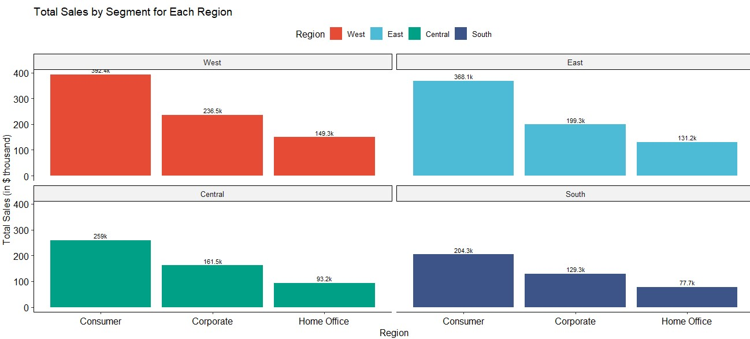
Q3c. Total Sales by Segment for Each Region
Purpose: Evaluate whether there are significant differences in Sales by Segment across Regions.
Question: How does Sales vary across Regions within each Segment?
Hypothesis: There are significant differences in Sales across Regions. This suggests that Regions perform variably in terms of sales. From a business perspective, this provides strong evidence that sales strategies differ considerably between regions.
Insights: The West is the top-performing region, achieving Total Sales of $778.3 million, while the South lags behind with approximately $411.2 million in Sales. Additionally, the Consumer Segment excels with Total Sales of approx. $1.22 million, whereas Home Office is the least performing category, totaling $451.3 thousand in Sales.
In all, Consumer from the West is the most performing with Total Sales of $392.4 thousand.
Olumide Balogun +234-8065060691
12

Slide 13
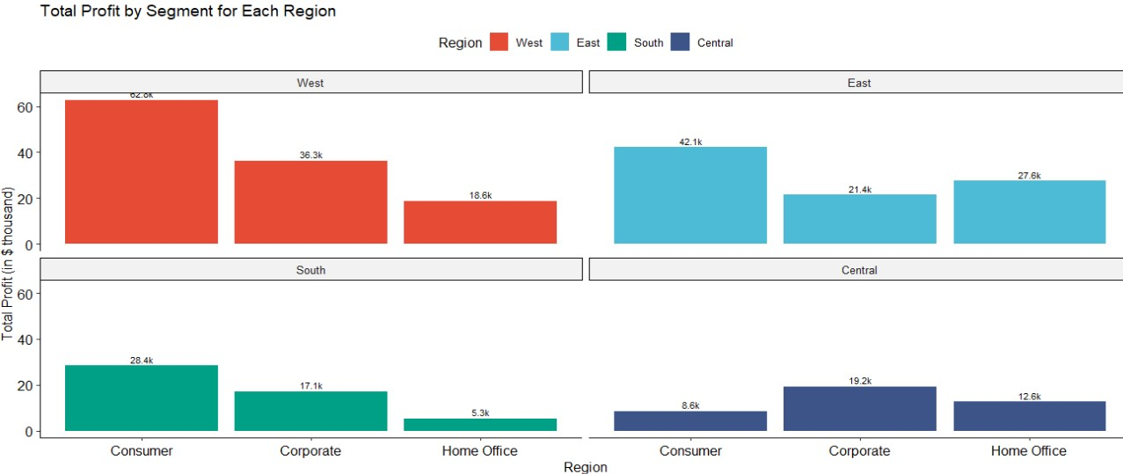
Q3d. Total Profit by Segment for Each Region
Purpose: : Evaluate whether there are significant differences in Profitability by Segment across Regions.
Question : How does Profit vary across Regions for each Segment?
Hypothesis: There are significant differences in Profit across Segment. This suggests that regions perform variably in terms of Profit. From a business perspective, this provides strong evidence that sales and profit strategies differ considerably between regions.
Insights: The West is the top-performing region, achieving Total Profit of $117.7 thousand, while the Central lags behind with approximately $40.5 thousand in Profit. Additionally, the Consumer Segment excels with Total Profit of $141.9 thousand, whereas Home Office is the least performing category, totaling $64.0 thousand in profit.
In all, Consumer from the West is the most performing with Total Profit of $62.8 thousand.
Olumide Balogun +234-8065060691
13

Slide 14
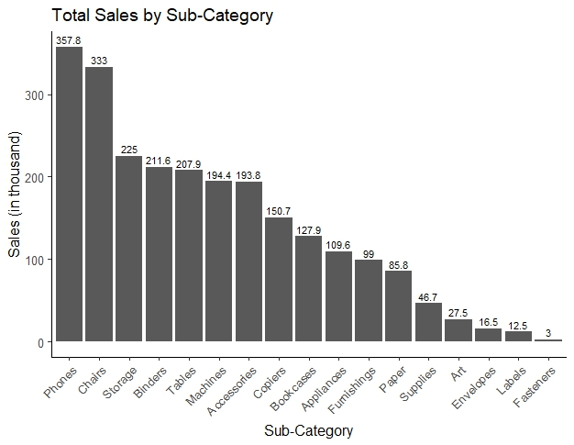
Q4a. Total Sales by Sub-Category
Purpose: Identify the Sub-categories that generate the highest Revenue.
Question : Which Subcategories that generate the highest Revenue?
Hypothesis: There are significant differences in Sales across the Subcategories
Insights: Phones and Chairs generated the most revenue among the sub-categories, with Phones contributing $357.8K and Chairs $333K. However, Storage, Blinders, Tables, Machines, and Accessories also show strong and promising revenue potential, while Fasteners is the underperforming sub-category.
Olumide Balogun +234-8065060691
14

Slide 15
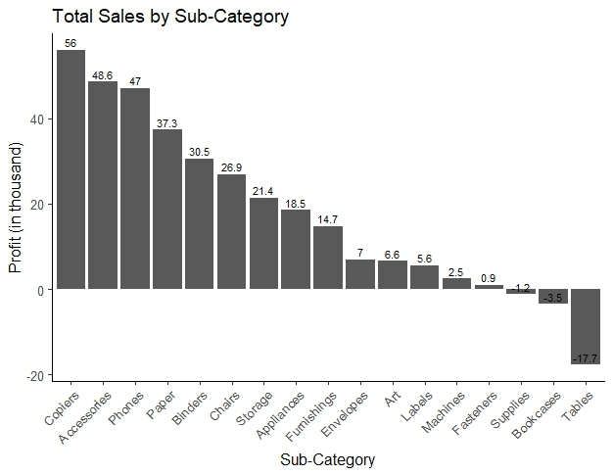
Q4b. Total Profit by Sub-Category
Purpose: To identify Sub-categories that are more Profitable than others.
Question : Are certain Subcategories more Profitable than others?
Hypothesis: There are significant differences in Profit across the Subcategories
Insights: Copiers, Accessories, and Phones are the three most profitable sub-categories, with Copiers generating $56K in profit, Accessories $48.6K, and Phones $47K. However, Paper, Blinders, and Chairs also show strong and promising profit potential, while Bookcases and Tables are the underperforming sub-categories
Olumide Balogun +234-8065060691
15

Slide 16
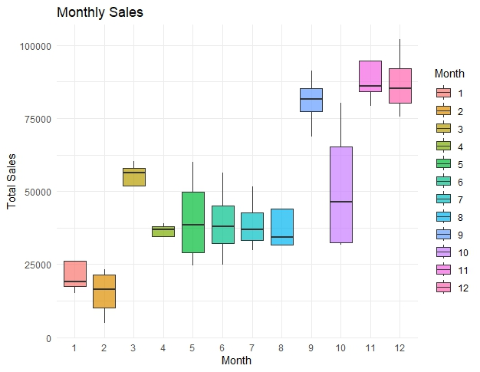
Q5. Monthly Sales Cyclical Patterns
Purpose: Compare Monthly Sales
Question : What Month recorded the Highest and Lowest Sales?
Hypothesis: A p-value of 0.0002097 indicates significant differences across the months.
Insights: December recorded the highest individual sales, while November achieved the highest total sales overall.
September, November, and December emerged as the best-performing months, with March and October also showing strong sales performance. In contrast, January and February were the lowest-performing months.
Olumide Balogun +234-8065060691
16

Slide 17
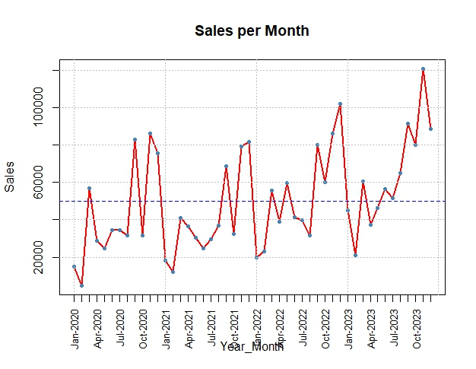
Q6. Month-over-Month Sales Comparison - Using Time Series Analysis
Purpose: Compare Sales Month-over-Month and Year-over-Year.
Question : Are we seeing Consistent Growth or Decline over Time?
Hypothesis: There is significant difference in growth among the years.
Insights: The growth has remained flat, but shows higher highs and higher lows in 2023, indicating that sales performance is improving significantly. The average sales over the years stood at over $50,000.
Olumide Balogun +234-8065060691
17

Slide 18
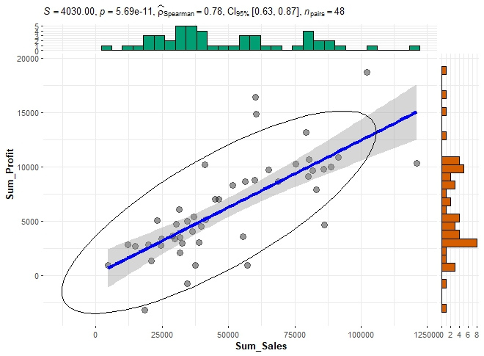
Q7a. The Impact of Sales on Profit
Purpose: Check if an increase in sales is positively correlated with profit growth.
Question : What is the correlation between Sales and Profit?
Hypothesis: There is a Strong Positive Relationship between Sales and Profit.
Insights: A correlation of 0.781 signifies a robust, positive, and statistically significant monotonic relationship between Sales and Profit. This suggests with 78.1% confidence that as Sales increase, Profit generally rises as well.
Olumide Balogun +234-8065060691
18

Slide 19
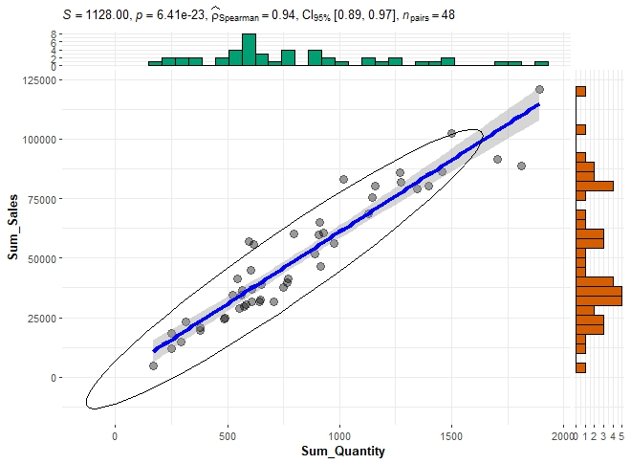
Q7b. The Impact of Quantity on Sales
Purpose: Examine whether an increase in the quantity sold is positively correlated with sales.
Question : What is the relationship between Sales and Quantity?
Hypothesis: There is a very High Positive Correlation between Sales and Quantity.
Insights: A value of 0.94 indicates a very strong, positive, and statistically significant monotonic relationship between Sales and Quantity. This reflects a 94% confidence level that as the Quantity Sold increases, Sales also tend to increase. The strength of this relationship is close to 100%.
Olumide Balogun +234-8065060691
19

Slide 20

Q7c. The Impact of Discount on Sales
Purpose: Examine whether an increase in the discount is positively correlated with sales.
Question : What is the relationship between Sales and Discount?
Hypothesis: There is a very High Positive Correlation between Sales and Discount.
Insights: A value of 0.92 indicates a very strong, positive, and statistically significant monotonic relationship between Sales and Discount. This reflects a 94% confidence level that as the Discount increases, Sales also tend to increase. The strength of this relationship is close to 100%.
Olumide Balogun +234-8065060691
20

Slide 21
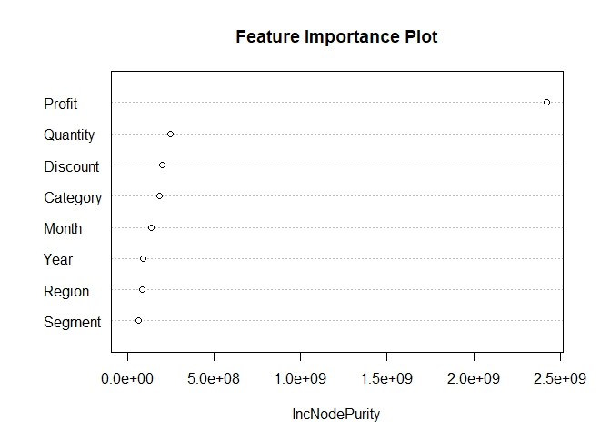
Q8a. Key Sales Performance Drivers: Insights from Feature Importance & Regression Analysis
Purpose: Discover the Core Drivers of Sales Performance using Random Forest and Regression Models
Question : What Key Factors Contribute to Sales Performance?
Hypothesis & Insights Based on Regression Model : Quantity: Each additional unit sold increases sales by approximately $47.33 (p < 2e-16), showing a strong positive correlation.
Discount: A one-unit increase in discount boosts sales by about $239.16 (p < 2e-16), indicating that discounts effectively drive sales.
Profit: An additional unit of profit raises sales by approximately $1.30 (p < 2e-16), reflecting a positive relationship, though less impactful than quantity and discount.
Focusing on these variables will be crucial in efforts to accelerate sales growth
Olumide Balogun +234-8065060691
21

Slide 22
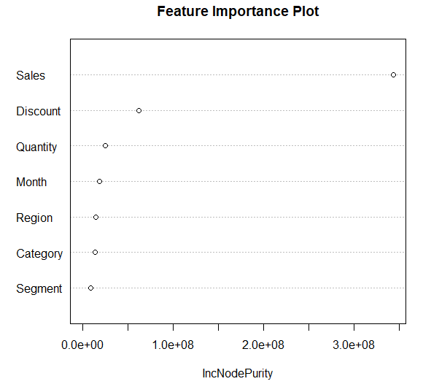
Q8b. Key Drivers of Profitability : Insights from Feature Importance & Regression Analysis
Purpose: Uncover the Essential Drivers of Profitability.
Question : What Key Factors Contribute to Profitability?
Hypothesis & Insights Based on Regression Model: Sales (0.1787): Each additional unit of sales increases profit by $0.1787, indicating a strong positive relationship with profit (p < 2e-16).
Quantity (-2.928): Each additional unit sold reduces profit by $2.93, showing a negative relationship between quantity and profit (p = 0.00098), potentially due to higher costs or lower-profit items.
Discount (-236.0): A one-unit increase in discount lowers profit by $236, indicating that larger discounts significantly reduce profitability (p < 2e-16).
These results suggest that both Quantity and Discount contribute to a reduction in profit.
Olumide Balogun +234-8065060691
22

Slide 23
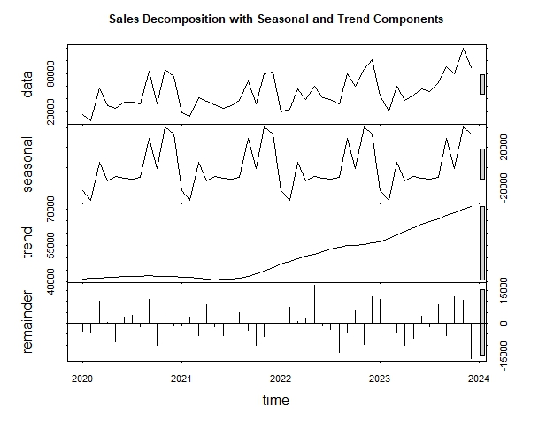
Q9. Sales Seasonality and Trend – using Decomposition
Purpose: Analyze the Sales Pattern across Months and Years in-order to identify Seasonality and Trends.
Question : Are there Seasonal Patterns, and what is the Sales Trend over Time?
Hypothesis & Insights. Yes, there are clear seasonal patterns. September, November, and December consistently show strong sales performance, with March also experiencing an upward trend, though not as high as the other three months.
While growth had remained flat, there has been a noticeable upward trend since mid-2021, indicating significant improvement in sales performance.
Olumide Balogun +234-8065060691
23

Slide 24
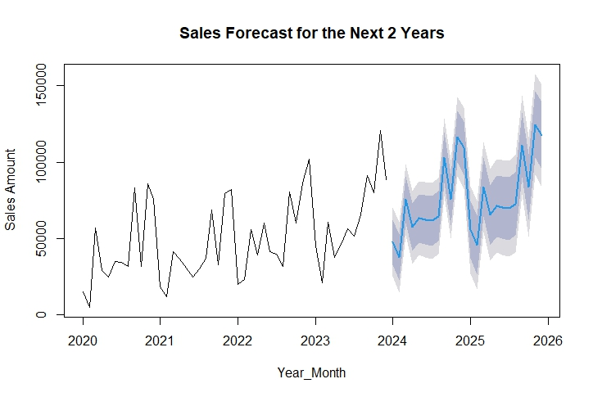
Q10. Projection of sales for the next thirty-six months – Using Time Series Forecast
Purpose: Predict future Sales values based on historical data using the ARIMA model.
Question : How will sales trends evolve over the next thirty-six months—will they be favorable or unfavorable?
Insights :
The observed upward trend in sales suggests a robust and growing market, indicating that customer demand is on the rise. This trend bodes well for sales outcomes over the next thirty-six months (three years), providing a strong foundation for strategic business planning and decision-making.
Several factors contribute to this upward trajectory:
Quantity Sold, Discount Strategies, Market Trends and Consumer Preferences, Profit Target, Economic Factors, …
Olumide Balogun +234-8065060691
24

Slide 25
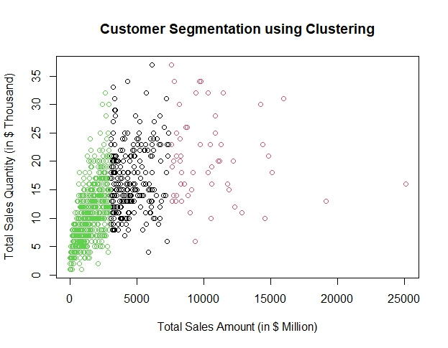
Q11. Clustering Model - for group of three (3)
Purpose: To segment customers based on buying behavior using the K-Means clustering model.
Question : Which customer segments drive the most sales?
Insights :
The customer segment that drives most of the sales is the category with sales starting from approximately $7,500+.This segment (third segment) is not clustered together like the others.
The second segment start from approximately $2,500 - $7,500, while the third segment are customers with a total sales Amount of less than approximately $2,500
Olumide Balogun +234-8065060691
25

Slide 26
Final Recommendations
1. Total Sales and Percentage Growth - Sales have grown by 19.65% in the last period, indicating a positive trend.
Action: Focus on the factors driving the growth
Strategy: Boost marketing in growth areas, improve weak segments, and keep pricing competitive.
Expected Impact: Attain a 15-20% sales growth, contributing to an overall increase in revenue
2. Regional Sales Strategy - Strengthen Presence in the Southern and Central Regions.
Action: Rebuild supply chain networks and increase investment in localized advertising. Strategy: Offer personalized solutions and bulk purchase discounts to key customers. Partner with local distributors and host promotional events to enhance brand visibility. Expected Impact: Achieve a 15-20% growth in sales, driving overall revenue increase.
3. Sub-Category Sales Strategy - Boost Marketing Efforts for Tables, Bookcases, Supplies, Fasteners, and Machines.
Action: Launch upgraded versions of these products with enhanced features at competitive pricing. Strategy: Increase product value perception by offering bundle deals with complementary accessories. Expected Impact: Regain lost market share and boost sales by 15-20%.
Olumide Balogun +234-8065060691
26

Slide 27
4. Monthly Sales Cyclical Patterns - Capitalize on seasonal trends to drive growth and enhance overall performance.
Action: Align marketing, promotions, and stock levels with these cyclical peaks.
Strategy: Implement time-bound campaigns to capitalize on high-demand periods (e.g., seasonal sales or events).
Expected Impact: With the potential for a 30-40% increase during peak sales months.
5. Month-over-Month Sales Comparison - Proactive inventory and marketing management to respond to demand fluctuations and mitigate negative external factors.
Action: Adjust sales and marketing strategies based on historical monthly performance
Strategy: Implement proactive inventory and marketing management to address demand fluctuations and devise corrective actions for unexpected trends.
Expected Impact: Achieved stable sales performance with a month-over-month growth increase of 10-15%.
6. Sales Seasonality and Trend - Create a seasonal promotion plan designed to boost revenue.
Action: Prepare marketing and sales teams for seasonal fluctuations while planning for steady long-term growth. Strategy: Develop a seasonal promotion plan that capitalizes on revenue opportunities during peak seasons while ensuring cost efficiency during off-peak periods. Expected Impact: Steady revenue growth of about 10-20%.
Olumide Balogun +234-8065060691
27

Slide 28
7. Customer Retention and Acquisition Strategy - Improve After-Sales Service for Retail Customers.
Action: Implement a comprehensive after-sales support program, featuring a dedicated helpline and quick-response team. Strategy: Provide extended warranties and personalized service for loyal customers. Expected Impact: Reduce churn rate by 7-10%, preserving significant revenue.
Leverage Online Sales Growth:
Action: Develop a robust e-commerce strategy with exclusive online offers and an optimized user experience. Strategy: Increase online sales and brand engagement.
8. Dynamic Pricing for High-Demand Products - Implement Dynamic Pricing for Phones and Chairs
Action: Apply dynamic pricing models based on demand trends and competitor pricing. Strategy: Increase prices in high-demand periods to boost profits and implement flash sales during low-demand periods to sustain sales momentum. Expected Impact: Increase profit margins by 10 - 15%, contributing to overall net revenue growth.
Olumide Balogun +234-8065060691
28

Slide 29
9. Customer-Centric Initiative - Strengthen High-Value Customer Engagement
Action: Launch a loyalty program offering exclusive benefits and early access to new products. Expected Impact: Improve high-value customer retention by 10 - 12%.
Engage Low-Value Customers
Action: Use predictive analytics to tailor personalized discounts and product recommendations. Expected Impact: Increase conversion rates by 15 - 20%.
10. Operational Efficiency Improvements - Optimize Supply Chain in Southern and Central Regions
Action: Partner with local logistics providers and invest in regional warehouses. Expected Impact: Reduce delivery times by 20%, enhancing customer satisfaction and lowering churn rates.
Olumide Balogun +234-8065060691
29

Slide 30
Implementation Plan
Immediate Actions (Next 1 Month): Kick off marketing campaigns, initiate partnerships with logistics providers, and launch dynamic pricing tests.
Short-Term Actions (Next 3 Months): Roll out new product upgrades, host promotional events, and develop e-commerce capabilities.
Long-Term Actions (6+ Months): Strengthen loyalty programs, optimize regional warehouses, and continuously monitor dynamic pricing impacts.
Conclusion
This final recommendation provides actionable insights and strategic recommendations for Smith & Robbins to achieve sustainable growth. By addressing key challenges and capitalizing on opportunities, the company is poised for 20+% increase in revenue by 2024. The focus on improving product offerings, enhancing regional presence, and boosting customer engagement ensures long-term success and competitiveness.
Olumide Balogun +234-8065060691
30

